Slide 1


Gold Price Alert
MINOR PROJECT REPORT
Submitted in partial fulfilment of the requirements of the degree of
BACHELOR OF TECHNOLOGY
By:
Name | Scholar Number
Mayank Jain | 19U02005
Kartikey Singh | 19U02006
Shivam Bist | 19U02048
Shikhar Verma | 19U02070
Under the Supervision of: Dr. Shalini Stalin
Department of Computer Science and Engineering
Indian Institute of Information Technology Bhopal
April 2022

Slide 2
Why this Topic?
Gold is an important asset of the financial market and in the long term, its value will only go up.
Lack of information regarding the time to invest in gold and the financial market situation.
Time is money - As time is the most important asset and TIME ASSETS are actions or choices we make today that will save our time in the future.

Slide 3
Why this application could be helpful at the time of COVID-19 and hike in prices of various commodities? Investing at this time will help people in their future, following are the reasons that will justify the importance of this program mainly in the case of investing in gold.
1. Best hedge to counter high inflation in the economy
Gold is the best indirect solution to the problems like debasement and inflation.
When the equity market crashed last year, gold had a bull run for several months- a trend that experts predict will continue in the current state of economic turmoil.
2. Extremely low rate of interest
In India , most of the monetary policies in 2022-23 are targeted to evolve macroeconomic conditions so that the economy can attain sustainable growth and inflation remains within an acceptable range.
Macroeconomics focuses on three things: National output, unemployment, and inflation.

Slide 4
Why this application could be helpful at the time of COVID-19 and hike in prices of various commodities? Investing at this time will help people in their future, following are the reasons that will justify the importance of this program mainly in the case of investing in gold.
3. Lucrative source for wealth creation considering the global pandemic
Gold has emerged as a major asset class during the current crisis. Its performance was fairly stable during the two waves of the pandemic, which made a lot of new investors hop onto the gold bandwagon.
The bandwagon effect is the term used to describe the tendency for people to adopt certain behaviors, styles, or attitudes simply because others are doing so.

Slide 5
Similar kind of Existing applications
There are some already existing applications that resolve the problem of keeping track of stocks and various other commodities.
Which are:
Stock Alarm
MoneyPatrol
Morningstar
Real-Time Stock

Slide 6
Limitations of existing applications:
Although the existing applications provide a tremendous amount of support and features there still exist various limitations that can be improved and worked upon.
Non-domestic Platform: Existing applications only provide coverage and investment opportunity that is internationally recognized, say we want to invest in local emerging companies of India and keep an eye on them, we won’t be able to do that through these applications.
Limited to Market Servers: The fetching of data is done through real-time servers of the commodity market and is hardcoded but our application is based on web-scraping and can fetch information from any website we put in.
Wide Range Alerts: Although they provide a good range of alert providing techniques from e-mails to SMS our application is the best in this case scenario. Our program can send alerts as Desktop notifications, WhatsApp messages, Beep sounds on PC, and SMS. So, we just have to sit back and relax.

Slide 7
What does this program bring to the table?
This program is equipped with information regarding a lot of entities in one place.
The (Unique Selling Proposition) USP of this program is that the user doesn't have to frequently and manually go to the interface of the program to check the current status of the entities.
User has to just set the program once to keep him/her updated regarding the status of the entity.

Slide 8
Challenges faced in making this application
Frequent changes in the website which we were fetching our data from.
Accommodate the changes in the layout of the website.
Using Twilio API is also a concern as it has a limit on the amount of SMS or WhatsApp messages we can send, so debugging becomes challenging.
Lack of testers: Being a team of only 4 people and unavailability of powerful machines to run big test cases it was quite exhaustive to cover all end cases.

Slide 9
Methodology and Framework
Tools used in making this project
BeautifulSoup: “BeautifulSoup” to perform web scrapping
Requests: “Requests” tool is used to send requests to the website
Winsound: “winsound” is for generating a beep sound
Win10toast: Used for notification generation on computer
Twilio API: Used to send SMS or WhatsApp messages to users.
Csv: “csv” files to store the downloaded data.
Importing Data
We had used the dataset available on (https://www.fresherslive.com/gold-rate-today) website and scraped it using the “BeautifulSoup” module. The site has good uptime, and we haven’t found any case of the website going down.
data =request.get("https://www.fresherslive.com/gold-rate-today/"+city)

Slide 10
Working process and algorithm
Importing the frameworks
Initialisation
Initialise the Twilio API’s variables used as parameters when we’ll send API to WhatsApp.
Send API function
Using the above initializations as parameters we created a function that’ll take text and input and send us SMS or WhatsApp message.
def SENDAPI(text):
client = Client(account_sid, auth_token)
message = client.messages.create(to=to, from_=frm,body=text)
Scraping:
With the help of “BeautifulSoup” module, the data will be scraped from the website (https://www.fresherslive.com/gold-rate-today) and will be parsed to a Python List, and then we will extract the information from the list accordingly. If the change is negative the Notification is sent via SMS or WhatsApp and Desktop Notification

Slide 11
Working process and algorithm
After downloading the dataset file in CSV format, we read the file using read.csv().
Then the scrapped data then goes to different segments for processing.
The segments are:
Firstly, we had extracted the city name from city.txt external file.
We had Scraped data from the site using “BeautifulSoup” module and parsed the HTML to a python list.
Next, we Printed the rate on the terminal.
We used the ‘alert system’ technique in which, the application makes beep sounds to alert the users according to the recent change in the gold price. For example-:
If the change is positive, it’ll play 2 beep sounds for 350ms and also.
If the change is negative, it’ll play 1 beep sound for 1000ms.

Slide 12
Frameworks: A framework, or software framework, is a platform that provides a foundation for developing software applications. Think of it as a template of a working program that can be selectively modified by adding code.
BeautifulSoup:- Web Scrapping Framework- to install the “BeautifulSoup” package in windows, use command : “pip install bs4”.
CSV module:- implements classes to read and write tabular data in CSV format.
Request Module:- Helps in sending HTTP requests using python.The HTTP request returns a Response Object with all the response data (content, encoding, status, etc).Method in request module: delete(), get(), head(), patch(), post(), put(), request().
Winsound Module: The winsound module provides access to the basic sound-playing machinery provided by Windows platforms. It includes functions and several constants. Methods in winsound module: Beep(), PlaySound(), MessageBeep(), etc.
Win10toast Module: Win10toast is used to create desktop notifications. It is an easy way to get notified when some event occurs.Some methods are ToastNotifier(), show_toast().

Slide 13
Frameworks: A framework, or software framework, is a platform that provides a foundation for developing software applications. Think of it as a template of a working program that can be selectively modified by adding code.
DateTime Module: datetime can be imported to work with the date as well as time. It supplies classes to work with date and time. DateTime module is categorized into 6 main classes – date, time, DateTime, timedelta, tzinfo, and timezone.
Twilio’s APIs: Twilio’s APIs (Application Programming Interfaces) power its platform for communications. Twilio provides much separate REST APIs (Representational State Transfer) for sending text messages, making phone calls, looking up phone numbers, managing your accounts, and a whole lot more.
OS.path Module:This module implements some useful functions on pathnames. To read or write files see open(), and for accessing the filesystem see the os module. The path parameters can be passed as either strings or bytes.

Slide 14
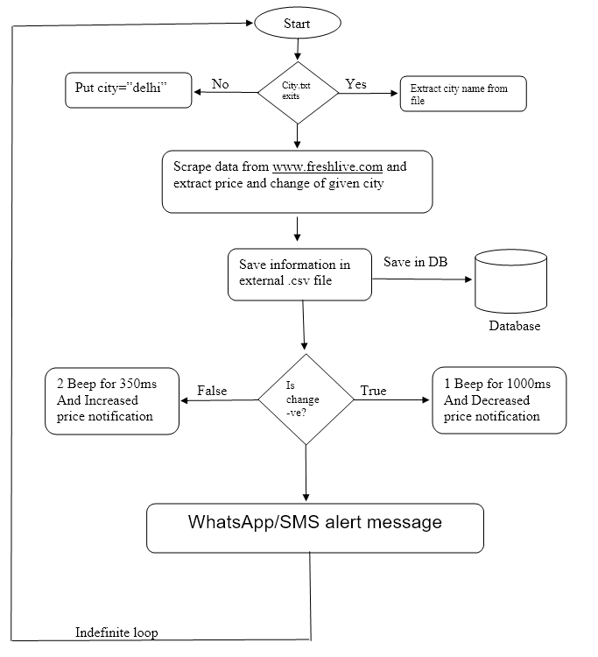
FLOW CHART

Slide 15
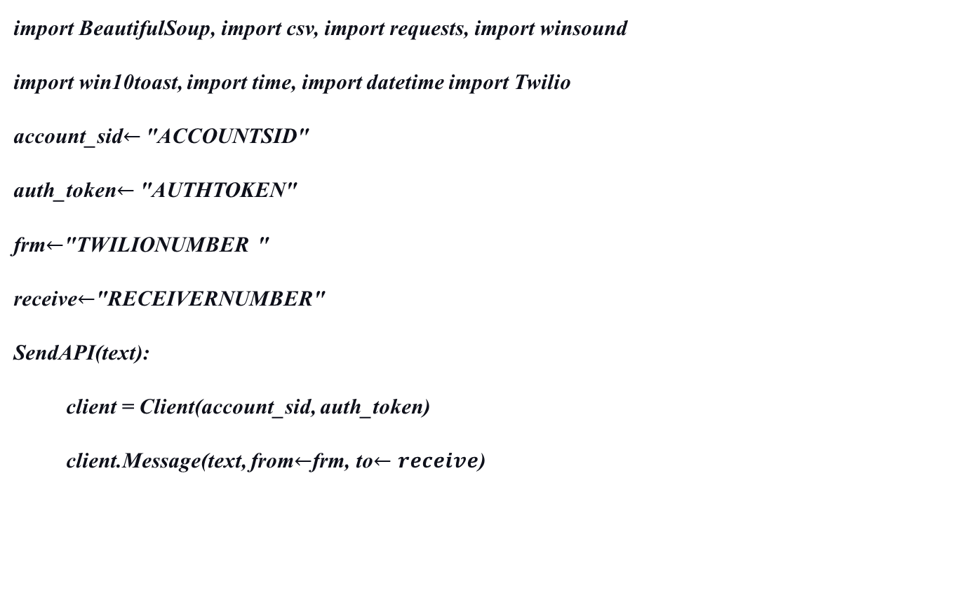
Algorithm (Pseudo Code)
import BeautifulSoup, import csv, import requests, import winsound
import win10toast, import time, import datetime import Twilio
account_sid$←$ "ACCOUNTSID"
auth_token$←$ "AUTHTOKEN"
frm$←$"TWILIONUMBER "
receive$←$"RECEIVERNUMBER"
SendAPI(text):
client = Client(account_sid, auth_token)
client.Message(text, from$←$frm, to$←receive$)

Slide 16

Algorithm (Pseudo Code)
while(True):
if('city.txt' file exists):
city$←$city_file.read()
else:
city$←$"delhi"
print("Looking for gold price in "+city)
Try:
data $←$Scrape("https://www.fresherslive.com/gold-rate-today/"+city)
HTML.parse(data)
price = soup.find_price_in_website
change = soup.find_change_in_website

Slide 17
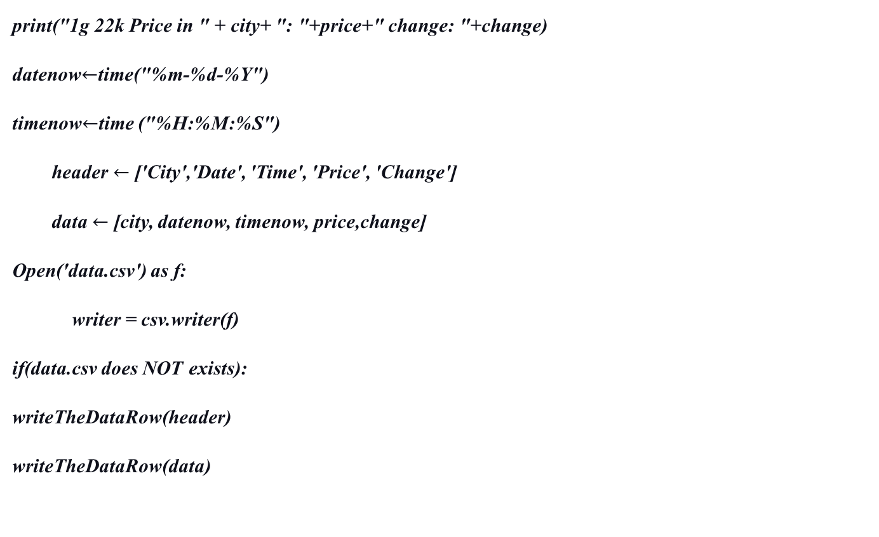
Algorithm (Pseudo Code)
print("1g 22k Price in " + city+ ": "+price+" change: "+change)
datenow$←$time("%m-%d-%Y")
timenow$←$time ("%H:%M:%S")
header $←$ ['City','Date', 'Time', 'Price', 'Change']
data $←$ [city, datenow, timenow, price,change]
Open('data.csv') as f:
writer = csv.writer(f)
if(data.csv does NOT exists):
writeTheDataRow(header)
writeTheDataRow(data)

Slide 18
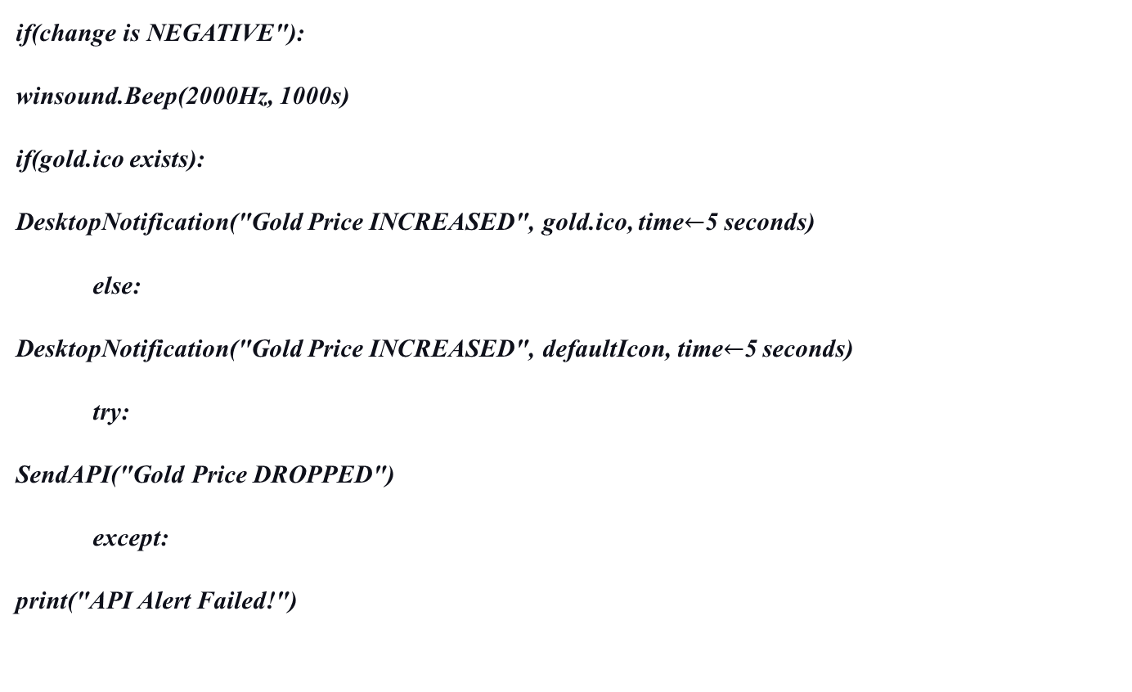
Algorithm (Pseudo Code)
if(change is NEGATIVE"):
winsound.Beep(2000Hz, 1000s)
if(gold.ico exists):
DesktopNotification("Gold Price INCREASED", gold.ico, time$←$5 seconds)
else:
DesktopNotification("Gold Price INCREASED", defaultIcon, time$←$5 seconds)
try:
SendAPI("Gold Price DROPPED")
except:
print("API Alert Failed!")

Slide 19
Algorithm (Pseudo Code)
if(change is POSITIVE"):
winsound.Beep(1000Hz, 350s)
winsound.Beep(1000Hz, 350s)
if(gold.ico exists):
DesktopNotification("Gold Price INCREASED", gold.ico, time=5 seconds)
else:
DesktopNotification("Gold Price INCREASED", defaultIcon, time=5 seconds)
try:
SendAPI("Gold Price INCREASED")
except:
print("API Alert Failed!")

Slide 20
Algorithm (Pseudo Code)
except:
print("City Not Found!")
time.sleep(5)

Slide 21
Conclusion To conclude, this project is like “All in one combo pack”, as it provides multiple functionalities to users. User just has to set the program once and he will get updated accordingly. This application is good as it provides various stock related services to its users and also overcomes the problems like constantly checking the gold rates and many other limitations that use has to go through.
It provides multiple functionalities to users. They’re:
Efficient results
User-friendly environment
Save time and efforts of user
Results of different cities
Notification on WhatsApp/SMS on mobile phone
Alerting sound system
Stock guidance whether to sell or buy
Notification on PC
Keep records of old data for better insights

Slide 22
Future Scope
We are living in a fast-growing world, we do not have enough time to look constantly for stock updates.
The project can provide us alerts on our mobile phones and on our PC, we just have to do what the application recommends us to do which is literally a no-brainer.
Among all the investable assets, the gold market has always been the most mature one.
Gold is one of the very few assets that are prone to high volatility or price swings. The value of gold has been observed to be increasing day by day. That’s the reason gold has always been viewed as a valuable asset for thousands of years.
Project can be updated and expanded in near future to accommodate various other investment opportunities like the stock market, cryptocurrency, etc., and provide up-to-date information, investment alerts, storage of previous data for better insights and most importantly saving time and efforts of the user.

Slide 23
References
GitHub Repository:
https://github.com/kartikeysingh6/kartik_python/tree/master/GoldPriceChecker
Working with CSV files in Python:
https://www.geeksforgeeks.org/working-csv-files-python/
Sound-playing interface for Windows:
https://docs.python.org/3/library/winsound.html
Python Datetime:
https://www.w3schools.com/python/python_datetime.asp
Scraping Website:
https://www.fresherslive.com/gold-rate-today/delhi
BeautifulSoup Documentation:
https://beautiful-soup-4.readthedocs.io/en/latest/
Twilio Rest API:
https://www.twilio.com/
BeautifulSoup Scraping Tutorial:
https://www.youtube.com/watch?v=87Gx3U0BDlo
Win10toast Documentation:
https://pypi.org/project/win10toast/
WhatsApp Business API with Twilio:
https://www.twilio.com/docs/whatsapp

